Slide 1
Unit 2: Arithmetic Expression & Precedence
PROG0101 Fundamentals of Programming
1

Slide 2
Operators in C
An operator is a symbol that tells the compiler to perform specific mathematical or logical functions.
C language is rich in built-in operators and provides the following types of operators −
Arithmetic Operators
Relational Operators
Logical Operators
Bitwise Operators
Assignment Operators
Misc Operators

Slide 3
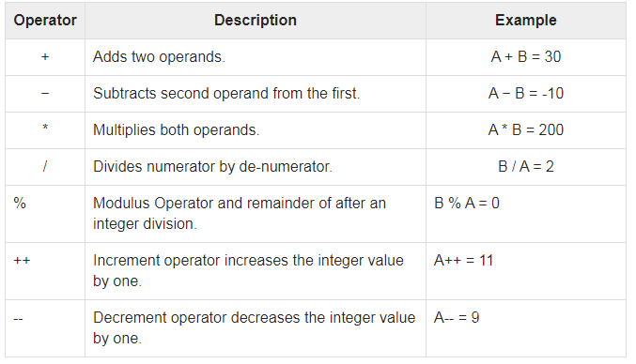
Arithmetic Operators
The following table shows all the arithmetic operators supported by the C language. Assume variable A holds 10 and variable B holds 20 then −

Slide 4
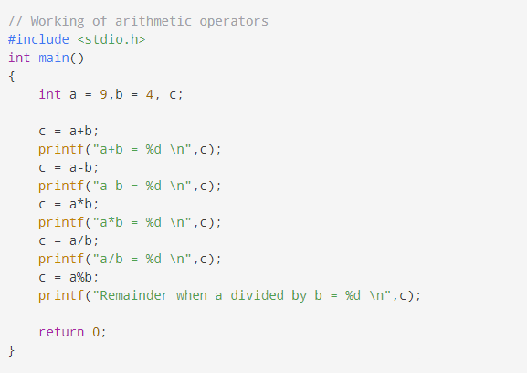
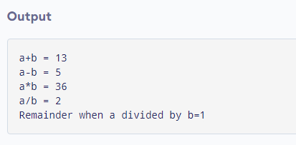
Example: Arithmetic Operators

Slide 5
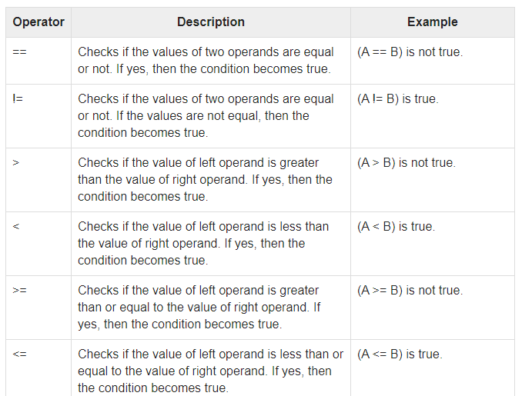
Relational Operators
The following table shows all the relational operators supported by C. Assume variable A holds 10 and variable B holds 20 then −

Slide 6
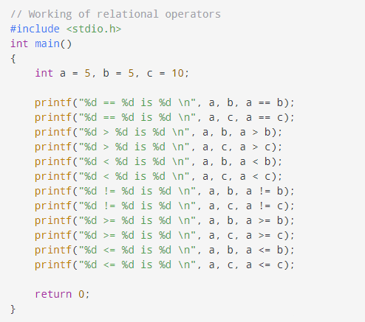
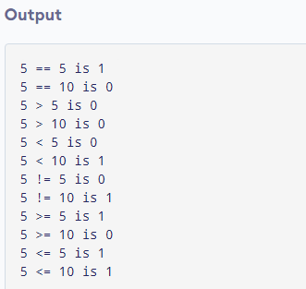
Example: Relational Operators

Slide 7
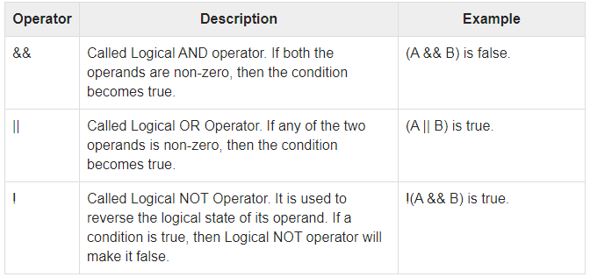
Logical Operators
Following table shows all the logical operators supported by C language. Assume variable A holds 1 and variable B holds 0, then −

Slide 8
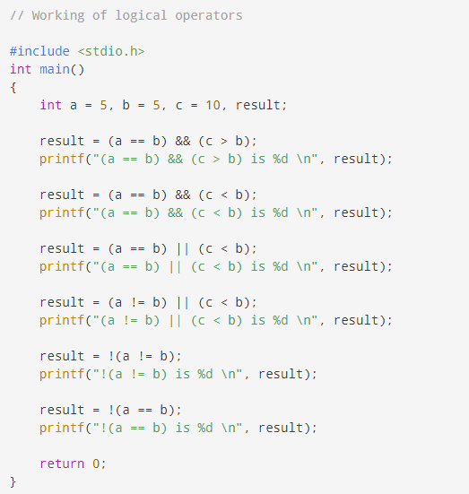
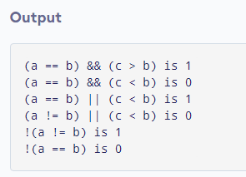
Example: Logical Operator

Slide 9
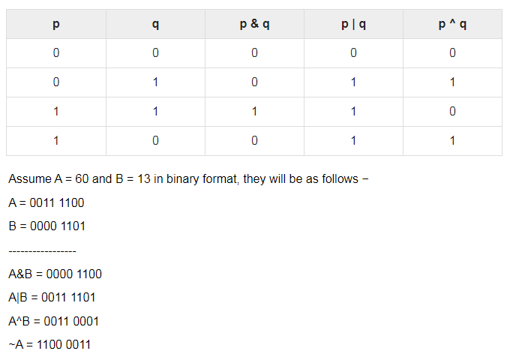
Bitwise Operators
Bitwise operator works on bits and perform bit-by-bit operation. The truth tables for &, |, and ^ is as follows −

Slide 10
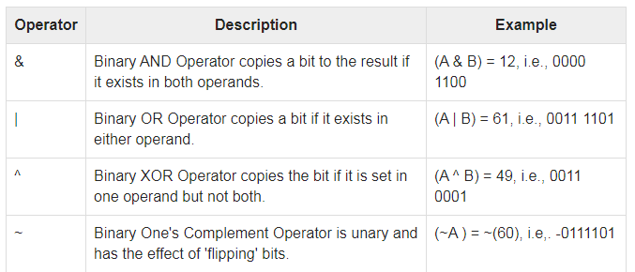
The following table lists the bitwise operators supported by C. Assume variable 'A' holds 60 and variable 'B' holds 13, then −

Slide 11
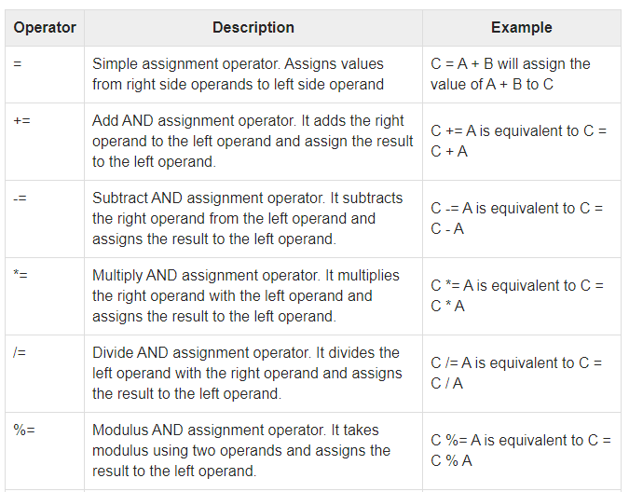
Assignment Operators
The following table lists the assignment operators supported by the C language −

Slide 12
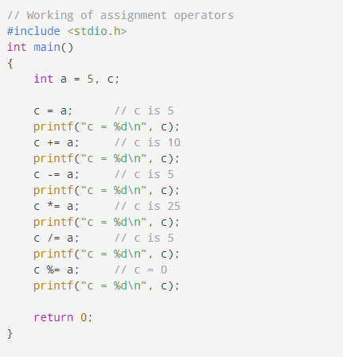
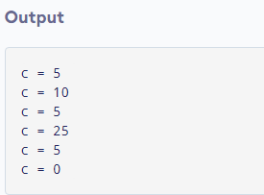
Example:Assignment Operators

Slide 13
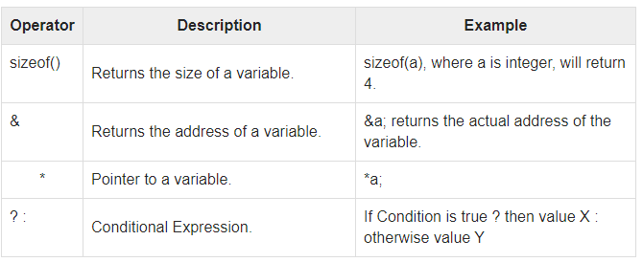
Misc Operators ↦ sizeof & ternary
There are a few other important operators including sizeof and ? : supported by the C Language.

Slide 14
Sizeof() Operator
The sizeof operator is the most common operator in C.
It is a compile-time unary operator and used to compute the size of its operand.
It returns the size of a variable. It can be applied to any data type, float type, pointer type variables.

Slide 15
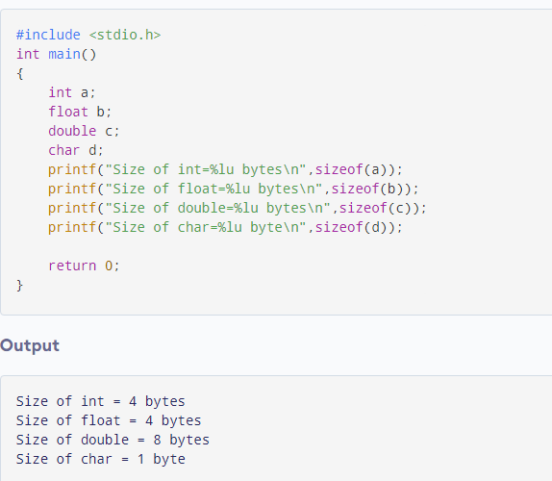
Example: sizeof Operator

Slide 16
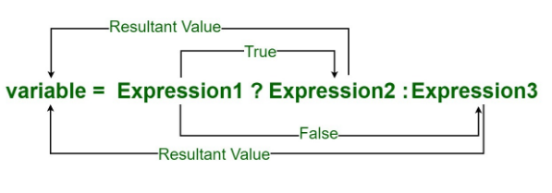
Ternary Operator
The ternary operator is an operator that exists in some programming languages, which takes three arguments:
1.The first is a comparison argument.
2.The second is the result upon a true comparison.
3.The third is the result upon a false comparison.
Syntax:

Slide 17
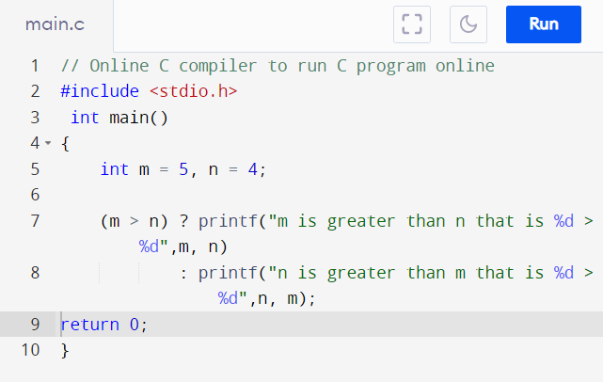
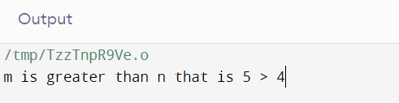
Example: Ternary Operator

Slide 18
Operators Precedence in C
Operator precedence determines the grouping of terms in an expression and decides how an expression is evaluated.
Certain operators have higher precedence than others; for example, the multiplication operator has a higher precedence than the addition operator.
For example, x = 7 + 3 * 2; here, x is assigned 13, not 20 because operator * has a higher precedence than +, so it first gets multiplied with 3*2 and then adds into 7.
Here, operators with the highest precedence appear at the top of the table, those with the lowest appear at the bottom. Within an expression, higher precedence operators will be evaluated first.

Slide 19
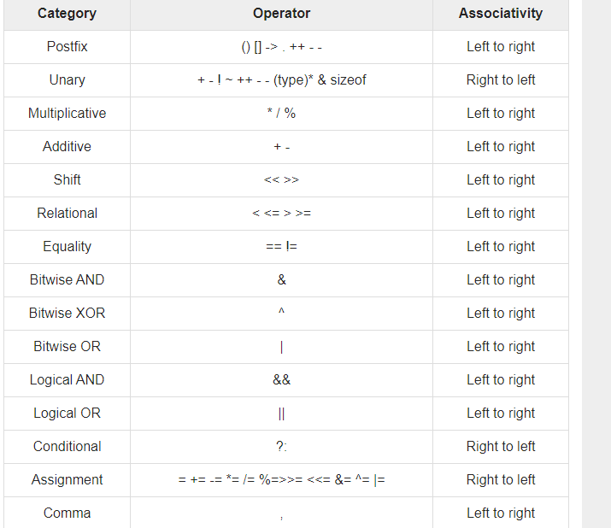

Slide 20
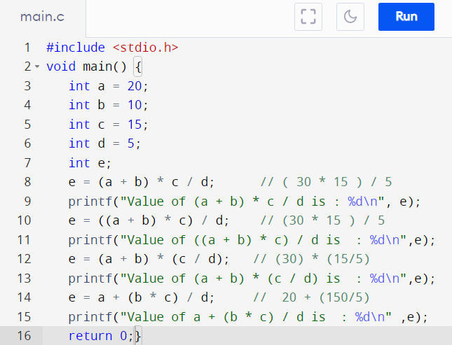
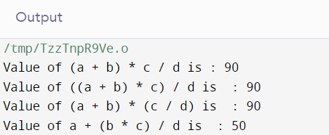
Example: Operator Precedence

